Slide 1

Inertial Measuring Unit
Presented by Vishnu Nair (27)
Shivam Singh (49)
Pratik Walawalkar (60)
Internal Guide:
Prof. Archana Belge
External Guide :
Mr. Ganesh Gore
Thakur College of Engineering and Technology – Electronics Department

Slide 2
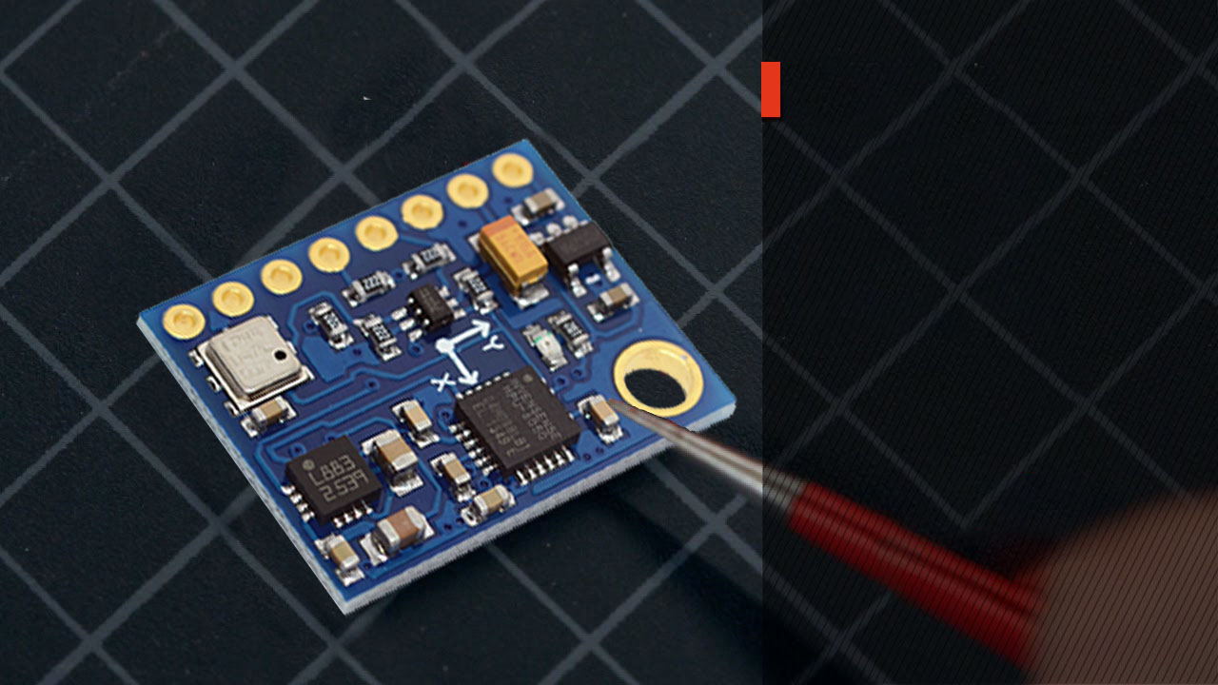
What is IMU?
It measures and logs specific force, angular rate, and sometimes the magnetic field surrounding an object
It uses a combination of accelerometers and gyroscopes, sometimes also magnetometers.

Slide 3
Components of IMU GY-87
MPU 6050 With Accelerometer and Gyroscope
Barometer
Accelerometer
Gyroscope
Magnetometer
Barometer
Digital Compass
Notes:
KB33 – Regulator IC
222 – 2.2K resistor
102 – 1K Resistor

Slide 4


Converting Raw Data
Required_value=$\frac{\text{raw}\text{_}\text{value}}{\text{proper}\text{_}\text{sensitivity}}$

Slide 5

Raw Data of Accelerometer
programmable full scale range of ±2g, ±4g, ±8g and ±16g
Ax | Ay | Az | Range | Sensitivity | X-Axis | Y-axis | Z-axis
-15608 | 5065 | 450 | 2g | 16384 | 0.95g | 0.31 | 0.027g
-945 | -4856 | 8159 | 4g | 8192 | 0.11g | 0.59g | 0.99g
256 | -255 | -3698 | 8g | 4096 | 0.06g | 0.06g | 0.9g
2655 | -589 | 898 | 16g | 2048 | 0.8g | 0.28g | 0.43g

Slide 6
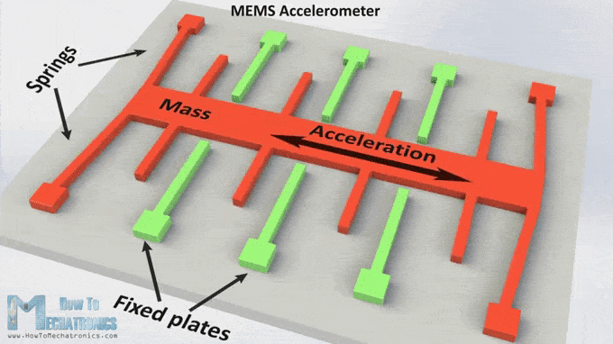
Working of Accelerometer

Slide 7

Raw Data of Gyroscope
programmable full scale range of ±250, ±500, ±1000, and ±2000°/sec
Gx | Gy | Gz | Range | Sensitivity | X-Axis | Y-axis | Z-axis
-349 | -204 | -247 | 250 | 131 | -2.66 | -1.355 | -1.88
65497 | 31 | 41 | 500 | 65.5 | 499.977 | 0.756 | 0.311
894 | 6512 | 23645 | 1000 | 32.8 | 27.25 | 198.53 | 720.88
2655 | -589 | 898 | 2000 | 16.4 | 161 | -35.91 | 54.75

Slide 8
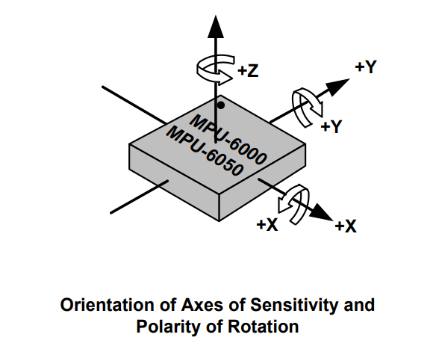
Orientation of Axes in Gyroscope

Slide 9

Magnetometer
Magnetometers refer to sensors used for sensing magnetic fields OR to systems which measure magnetic field using one or more sensors.
It records 3 magnitude X, Y & Z
Coordinate system used is geographic (XYZ)

Slide 10
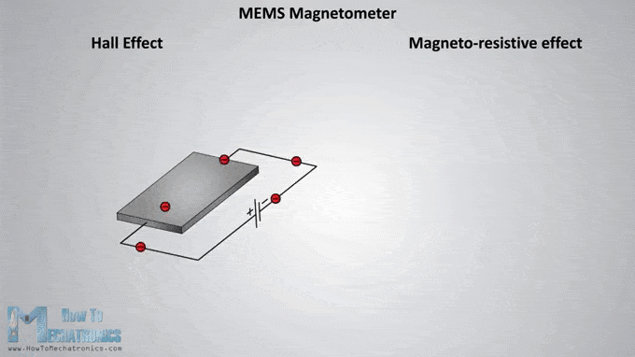
Working of Magnetometer

Slide 11
Arduino IDE
Downloaded ‘I2C’ library
Downloaded Library for MPU 6050
Interfacing Arduino UNO+ GY-87
Trial run of Program

Slide 12

Processing Software
Downloaded Library “Toxi”
Edited Code For MPU 6050

Slide 13
Reference Video
Video:
https://www.youtube.com/watch?v=x2vVsO5Hr2I
Blogs:
http://hotresistor.blogspot.in/2015/09/interfacing-arduino-with-gy-87.html
https://diyhacking.com/arduino-mpu-6050-imu-sensor-tutorial/

Slide 14
Thank You

